Slide 1
MAT 125 Linear Combination
Mohammad Mahmud Hasan
Department of Mathematics and Physics
30 March 2020

Slide 2
Outline:
Linear Combination
Spanning Set

Slide 3
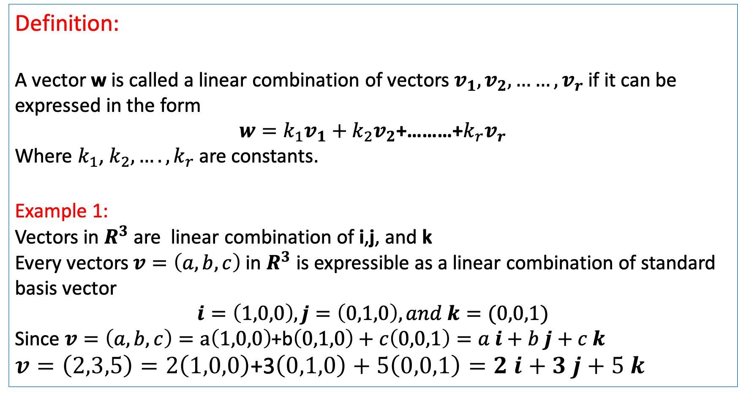
Linear Combination
Definition:
A vector w is called a linear combination of vectors $v_{1},v_{2},……,v_{r}$ if it can be expressed in the form
$w=k_{1}v_{1}+k_{2}v_{2}$+………+$k_{r}v_{r}$
Where $k_{1}$, $k_{2},….,k_{r}$are constants.
Example 1:
Vectors in $R^{3}$ are linear combination of i,j, and k
Every vectors $v=\left(a,b,c\right)$ in $R^{3}$ is expressible as a linear combination of standard basis vector
$i=\left(1,0,0\right),j=\left(0,1,0\right), and k=(0,0,1)$
Since $v=\left(a,b,c\right)=a\left(1,0,0\right)$+b$\left(0,1,0\right)+c\left(0,0,1\right)=a i+b j+c k$
$v=\left(2,3,5\right)=2\left(1,0,0\right)$+3$\left(0,1,0\right)+5\left(0,0,1\right)=2 i+3 j+5 k$

Slide 4
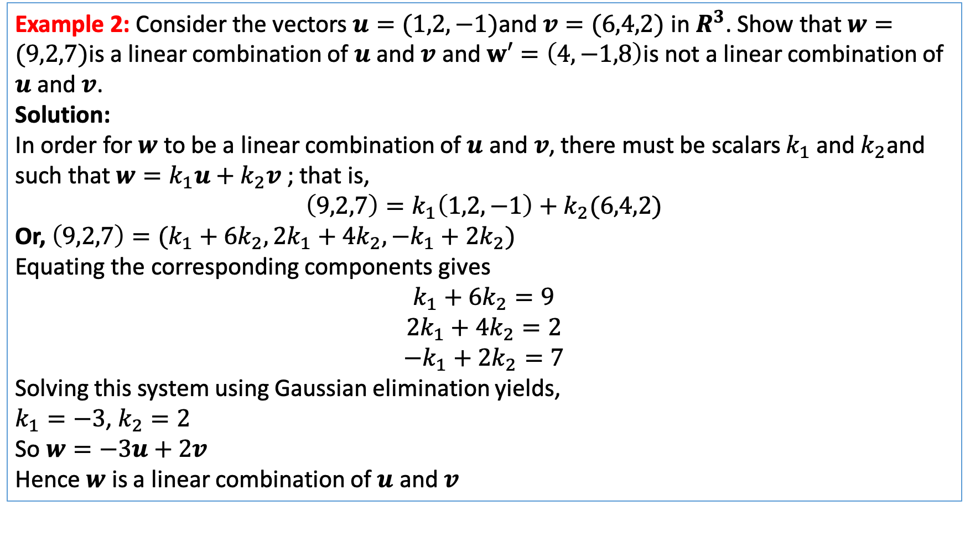
Linear Combination
Example 2: Consider the vectors $u=(1,2,−1)$and $v=(6,4,2)$ in $R^{3}$. Show that $w=(9,2,7)$is a linear combination of $u$ and $v$ and $w′=\left(4,−1,8\right)$is not a linear combination of $u$ and$v$.
Solution:
In order for $w$ to be a linear combination of $u$ and$v$, there must be scalars $k_{1}$ and${ k}_{2}$and such that $w=k_{1}u+k_{2}v$ ; that is,
$$\left(9,2,7\right)=k_{1}\left(1,2,−1\right)+k_{2}(6,4,2)$$
Or, $\left(9,2,7\right)=(k_{1}+6k_{2},2k_{1}+4k_{2},−k_{1}+2k_{2})$
Equating the corresponding components gives
$$k_{1}+6k_{2}=9$$
$$2k_{1}+4k_{2}=2$$
$$−k_{1}+2k_{2}=7$$
Solving this system using Gaussian elimination yields,
$k_{1}=−3$, $k_{2}=2$
So $w=−3u+2v$
Hence $w$ is a linear combination of $u$ and$v$

Slide 5
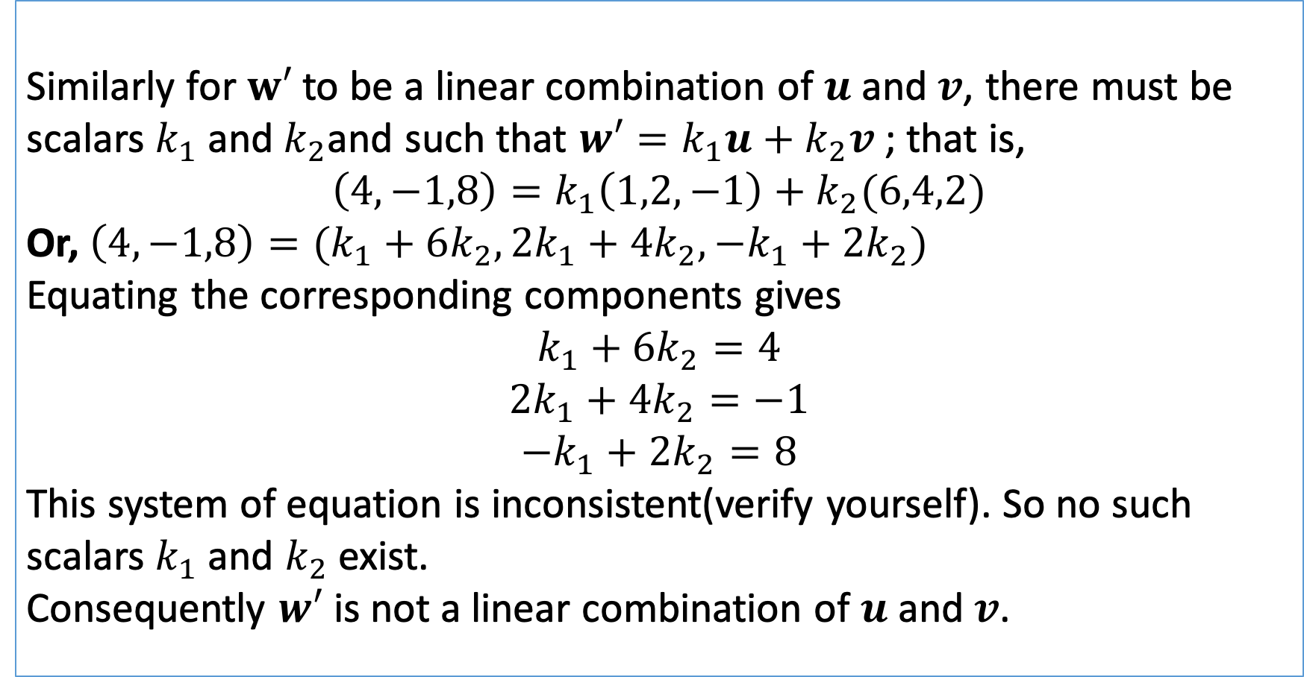
Linear combination
Similarly for $w′$ to be a linear combination of $u$ and$v$, there must be scalars $k_{1}$ and${ k}_{2}$and such that $w′=k_{1}u+k_{2}v$ ; that is,
$$\left(4,−1,8\right)=k_{1}\left(1,2,−1\right)+k_{2}(6,4,2)$$
Or, $\left(4,−1,8\right)=(k_{1}+6k_{2},2k_{1}+4k_{2},−k_{1}+2k_{2})$
Equating the corresponding components gives
$$k_{1}+6k_{2}=4$$
$$2k_{1}+4k_{2}=−1$$
$$−k_{1}+2k_{2}=8$$
This system of equation is inconsistent(verify yourself). So no such scalars $k_{1}$ and $k_{2}$ exist.
Consequently $w′$ is not a linear combination of $u$ and$v$.

Slide 6
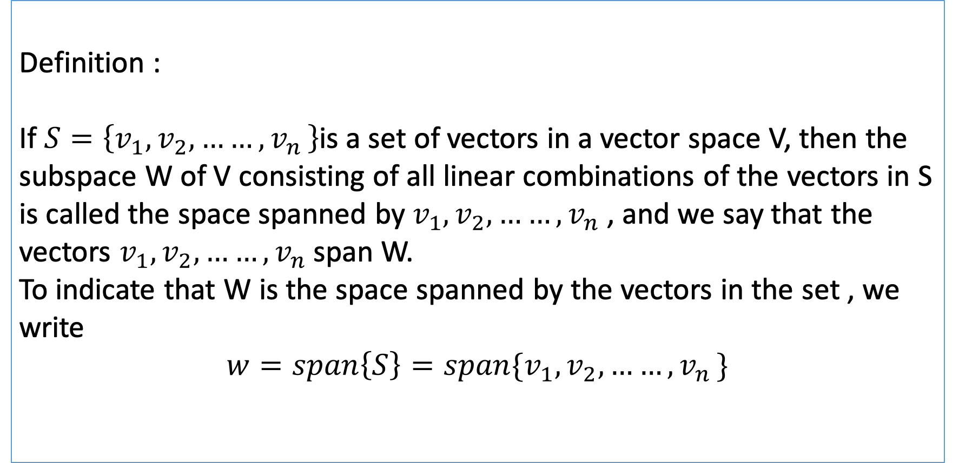
Spanning set
Definition :
If $S=\left\{v_{1},v_{2},……{,v}_{n}\right\}$is a set of vectors in a vector space V, then the subspace W of V consisting of all linear combinations of the vectors in S is called the space spanned by${ v}_{1},v_{2},……{,v}_{n}$ , and we say that the vectors $v_{1},v_{2},……{,v}_{n}$span W.
To indicate that W is the space spanned by the vectors in the set , we write
$$w=span\left\{S\right\}=span\{v_{1},v_{2},……{,v}_{n}\}$$

Slide 7
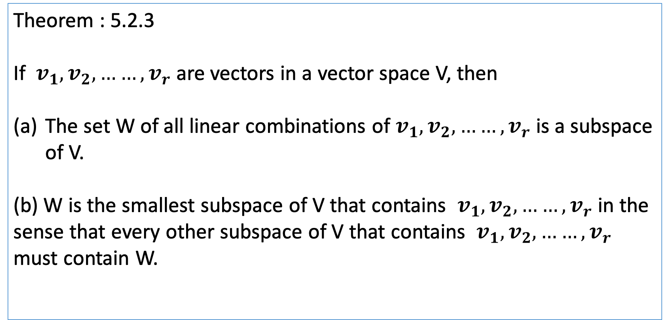
Spanning Set
Theorem : 5.2.3
If ${ v}_{1},v_{2},……{,v}_{r}$ are vectors in a vector space V, then
The set W of all linear combinations of${ v}_{1},v_{2},……{,v}_{r}$ is a subspace of V.
(b) W is the smallest subspace of V that contains ${ v}_{1},v_{2},……{,v}_{r}$ in the sense that every other subspace of V that contains ${ v}_{1},v_{2},……{,v}_{r}$ must contain W.

Slide 8
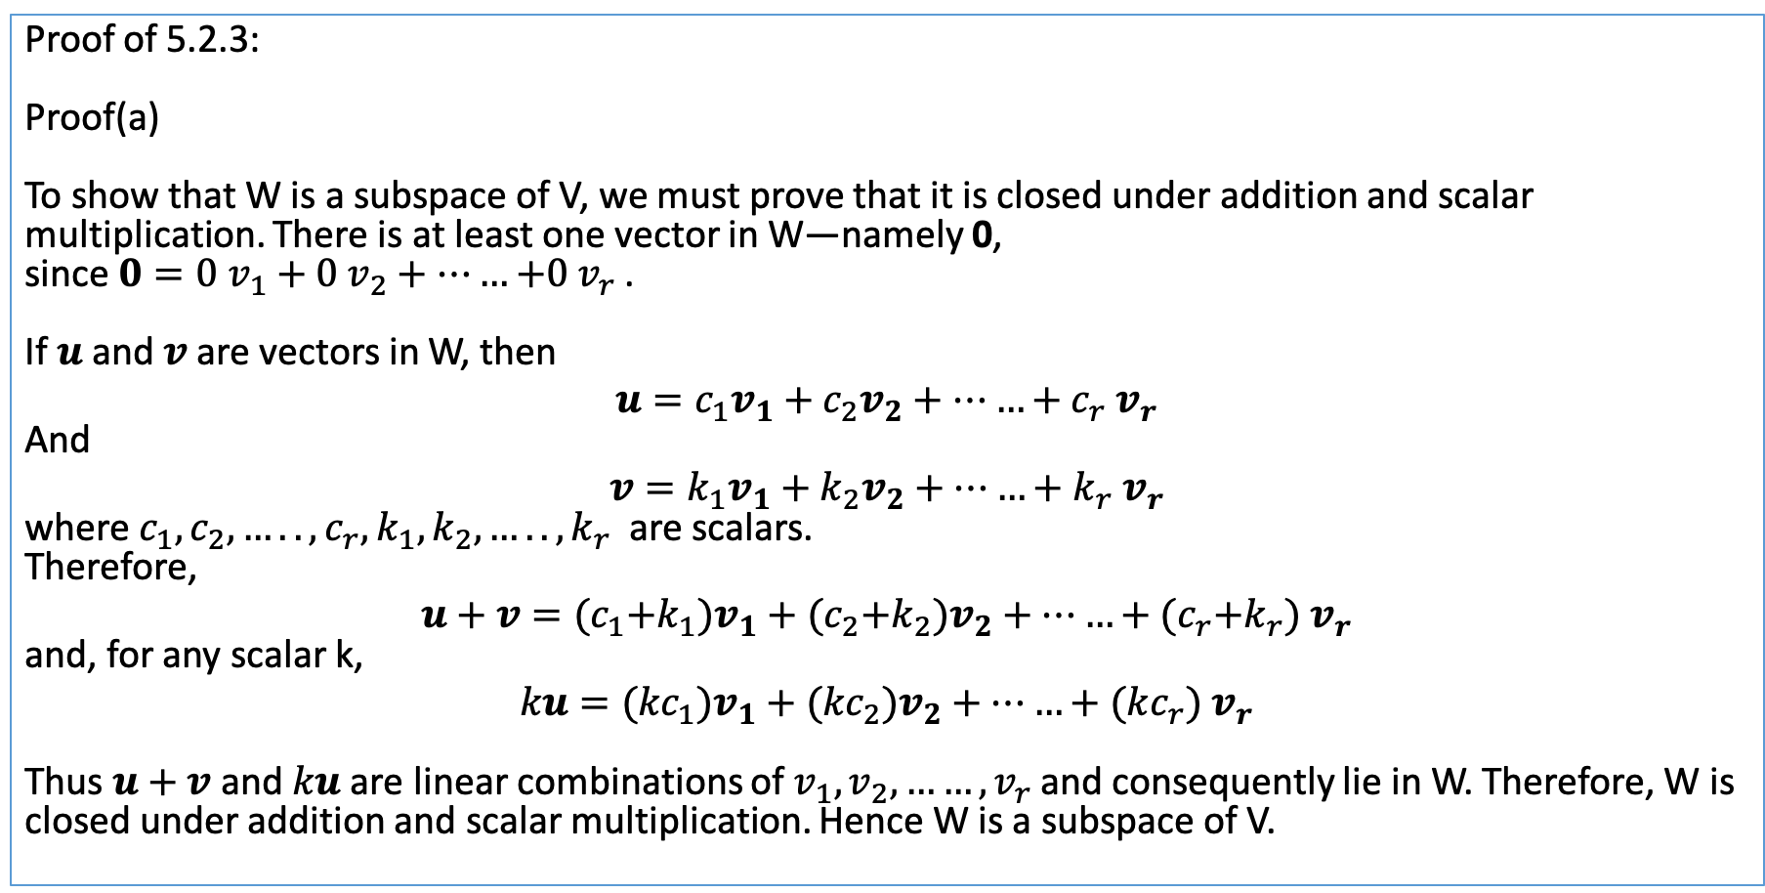
Spanning Set
Proof of 5.2.3:
Proof(a)
To show that W is a subspace of V, we must prove that it is closed under addition and scalar multiplication. There is at least one vector in W—namely 0,
since ${0=0 v}_{1}+0 v_{2}+……{+0 v}_{r}$ .
If $u$and $v$ are vectors in W, then
$$u=c_{1}v_{1}+c_{2}v_{2}+……+c_{r}{ v}_{r}$$
And
$$v=k_{1}v_{1}+k_{2}v_{2}+……+k_{r}{ v}_{r}$$
where $c_{1},c_{2},…..,c_{r},k_{1},k_{2},…..,k_{r}$ are scalars.
Therefore,
$$u+v={(c}_{1}+k_{1})v_{1}+{(c}_{2}+k_{2})v_{2}+……+{(c}_{r}+k_{r}){ v}_{r}$$
and, for any scalar k,
$$ku={(kc}_{1})v_{1}+{(kc}_{2})v_{2}+……+(kc_{r}){ v}_{r}$$
Thus $u+v$and $ku$ are linear combinations of $v_{1},v_{2},……{,v}_{r}$ and consequently lie in W. Therefore, W is
closed under addition and scalar multiplication. Hence W is a subspace of V.

Slide 9
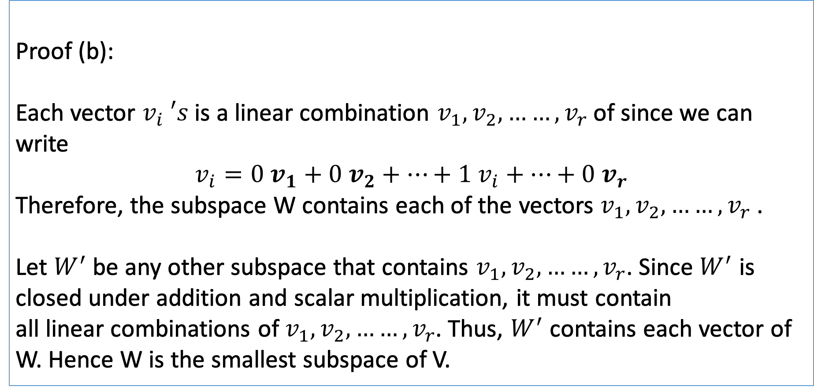
Spanning set
Proof (b):
Each vector $v_{i} ′s$ is a linear combination $v_{1},v_{2},……{,v}_{r}$ of since we can write
$$v_{i}=0 v_{1}+0 v_{2}+…+1 v_{i}+…+0{ v}_{r}$$
Therefore, the subspace W contains each of the vectors $v_{1},v_{2},……{,v}_{r}$ .
Let $W^{′}$be any other subspace that contains $v_{1},v_{2},……{,v}_{r}$. Since $W^{′}$ is closed under addition and scalar multiplication, it must contain
all linear combinations of $v_{1},v_{2},……{,v}_{r}$. Thus, $W^{′}$ contains each vector of W. Hence W is the smallest subspace of V.

Slide 10

Spanning set
Example 1:
If $v_{1}$ and $v_{2}$ are noncollinear vectors in $R^{3}$ with their initial points at the origin, then span{$v_{1}$, $v_{2}$} , which consists of all linear combinations $k_{1}v_{1}+k_{2}v_{2}$, is the plane determined by $v_{1}$ and $v_{1}$(see Figure a). Similarly, if $v$ is a nonzero vector in $R^{2}$or $R^{3}$, then span{$v$} , which is the set of all scalar multiples $kv$, is the line determined by $v$ (see Figure b).

Slide 11
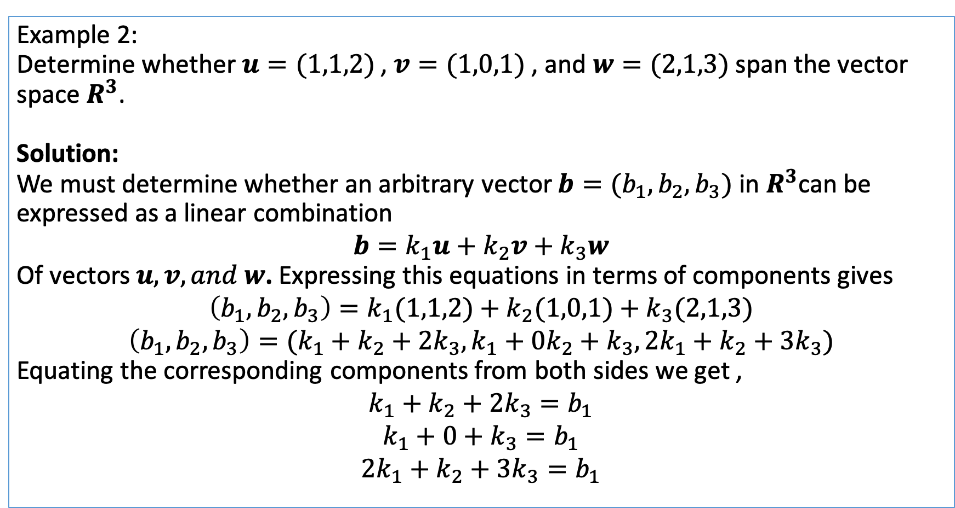
Spanning set
Example 2:
Determine whether $u=(1,1,2)$ , $v=(1,0,1)$ , and $w=(2,1,3)$span the vector space $R^{3}$.
Solution:
We must determine whether an arbitrary vector $b=(b_{1},b_{2},b_{3})$ in $R^{3}$can be expressed as a linear combination
$$b=k_{1}u+k_{2}v+k_{3}w$$
Of vectors $u,v, and w$. Expressing this equations in terms of components gives
$$\left(b_{1},b_{2},b_{3}\right)=k_{1}(1,1,2)+k_{2}(1,0,1)+k_{3}(2,1,3)$$
$$\left(b_{1},b_{2},b_{3}\right)=(k_{1}+k_{2}+{2k}_{3},k_{1}+0k_{2}+k_{3}, 2k_{1}+k_{2}+3k_{3})$$
Equating the corresponding components from both sides we get ,
$$k_{1}+k_{2}+{2k}_{3}=b_{1}$$
$${k_{1}+0+k_{3}=b}_{1}$$
$${2k_{1}+k_{2}+3k_{3}=b}_{1}$$

Slide 12
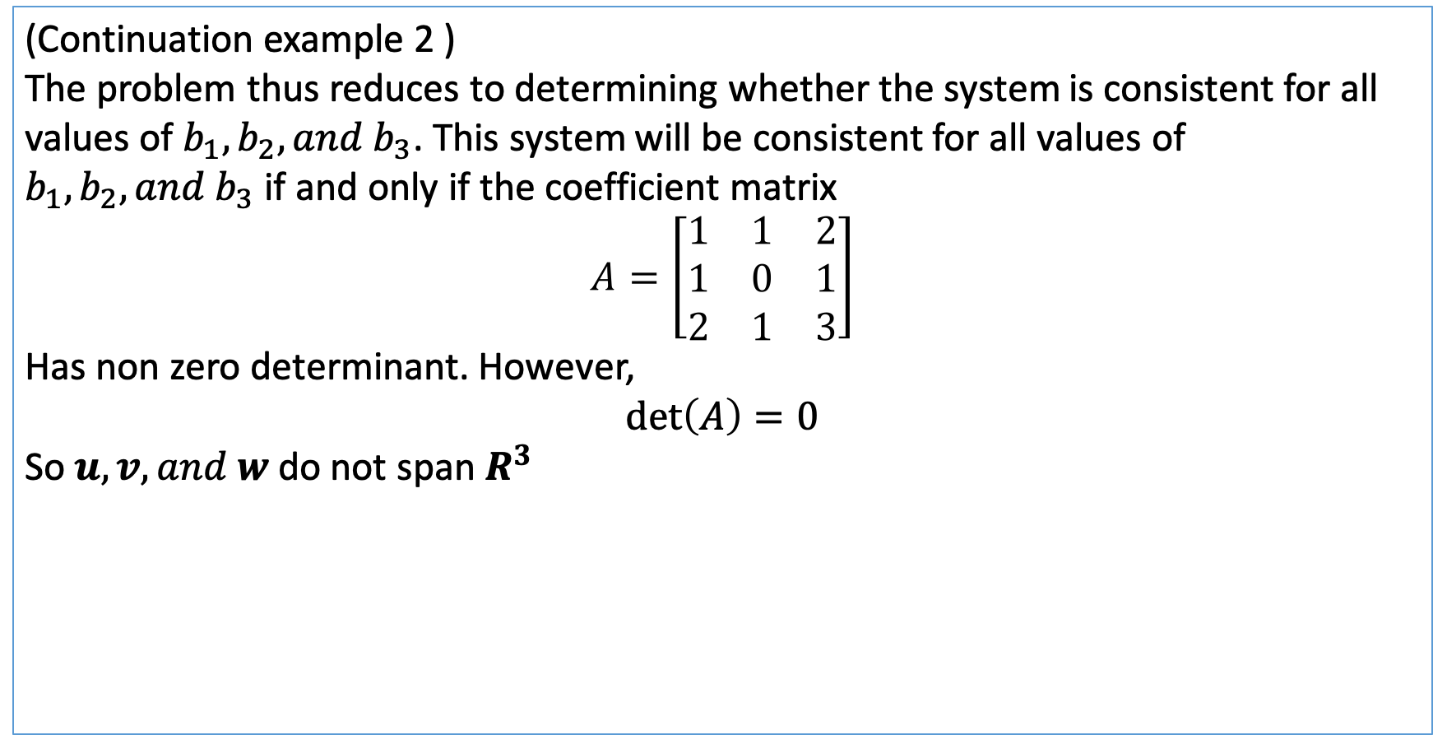
Spanning Set
(Continuation example 2 )
The problem thus reduces to determining whether the system is consistent for all values of $b_{1},b_{2}, and b_{3}$. This system will be consistent for all values of $b_{1},b_{2}, and b_{3}$ if and only if the coefficient matrix
$$A=\left[\begin{matrix}1 & 1 & 2 \\ 1 & 0 & 1 \\ 2 & 1 & 3\end{matrix}\right]$$
Has non zero determinant. However,
$$\det\left(A\right)=0$$
So $u,v, and w$ do not span $R^{3}$

